Slide 1

Island Reservation
Abdel Alnajjar (PO) - Backend
Suneet Bhandari - Frontend
Minghui Wen - Frontend
Maiah Pardo - Frontend
Jonathan Ly - Backend
Jose Jimenez - Backend
Wilson Chen - Frontend/Backend

Slide 2
Brief Introduction
Island Reservation allows our customers to upload their own islands, or place a reservation to experience the vacation of their dreams.
– – – – – – – – – –
“You have your yacht, your jet, now you want your island,”
says John Christie, the president of Christie’s International Real Estate,
a firm who sells islands to the mega-wealthy. Christie claims that island
brokers are currently overwhelmed.
Notes:
Driven by the coronavirus pandemic, the wealthy now want to escape to a private, isolated paradise.
“You have your yacht, your jet, now you want your island,” says John Christie, the president of Christie’s International Real Estate, a firm who sells islands to the mega-wealthy. Christie claims that island brokers are currently overwhelmed.
Along with natural islands, new artificial islands continue to be created
all over the world.
Island ownership is a new interest, but even island owners can’t be in
two places at once, and when not residing in their tropical luxury,
others may want to.
Island Reservation allows our customers to post their own
island, or place a reservation to experience the vacation
of their dreams.

Slide 3
Goals
Wanted to achieve:
a mobile-friendly website that can do the following operations:
signup
secure login/logout system
display available islands
sorting by different criteria
allow users to make reservations
display user account info
Notes:
Having a mobile-friendly website that can do the following operations:
allow new users to signup
host a secure login/logout system
display available island bookings on a gallery page
allow the list of available bookings to be sorted by different criteria
allow users to make bookings
show user account information including their bookings

Slide 4
Goals
We achieved:
a website that can do the following operations:
signup
secure login/logout system
display available islands
sorting by different criteria (price, land size, rating)
allow users to make reservations
allow users to add/update islands
display and manage user account info
display and manage user account balance
allow users to leave reviews on islands
display map of all of the islands + user’s current location
include an about page for the team + product

Slide 5
Biggest challenges
Agreeing on technologies
Learning new technologies
Communication
Delegating tasks
Planning out sprints

Slide 6
Biggest accomplishments
Making a website with unfamiliar technologies
Getting multiple features done simultaneously and keeping
constant communication
Holding organized scrum meetings
Coming up with a project from scratch

Slide 7
Live Demo

Slide 8
System Overview

Slide 9
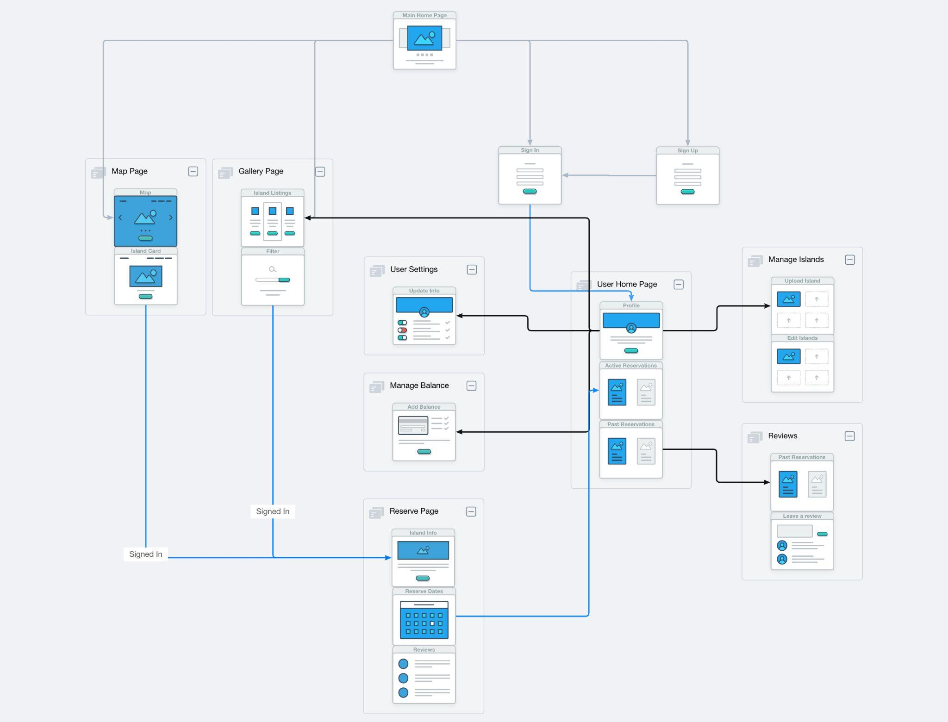

Slide 10
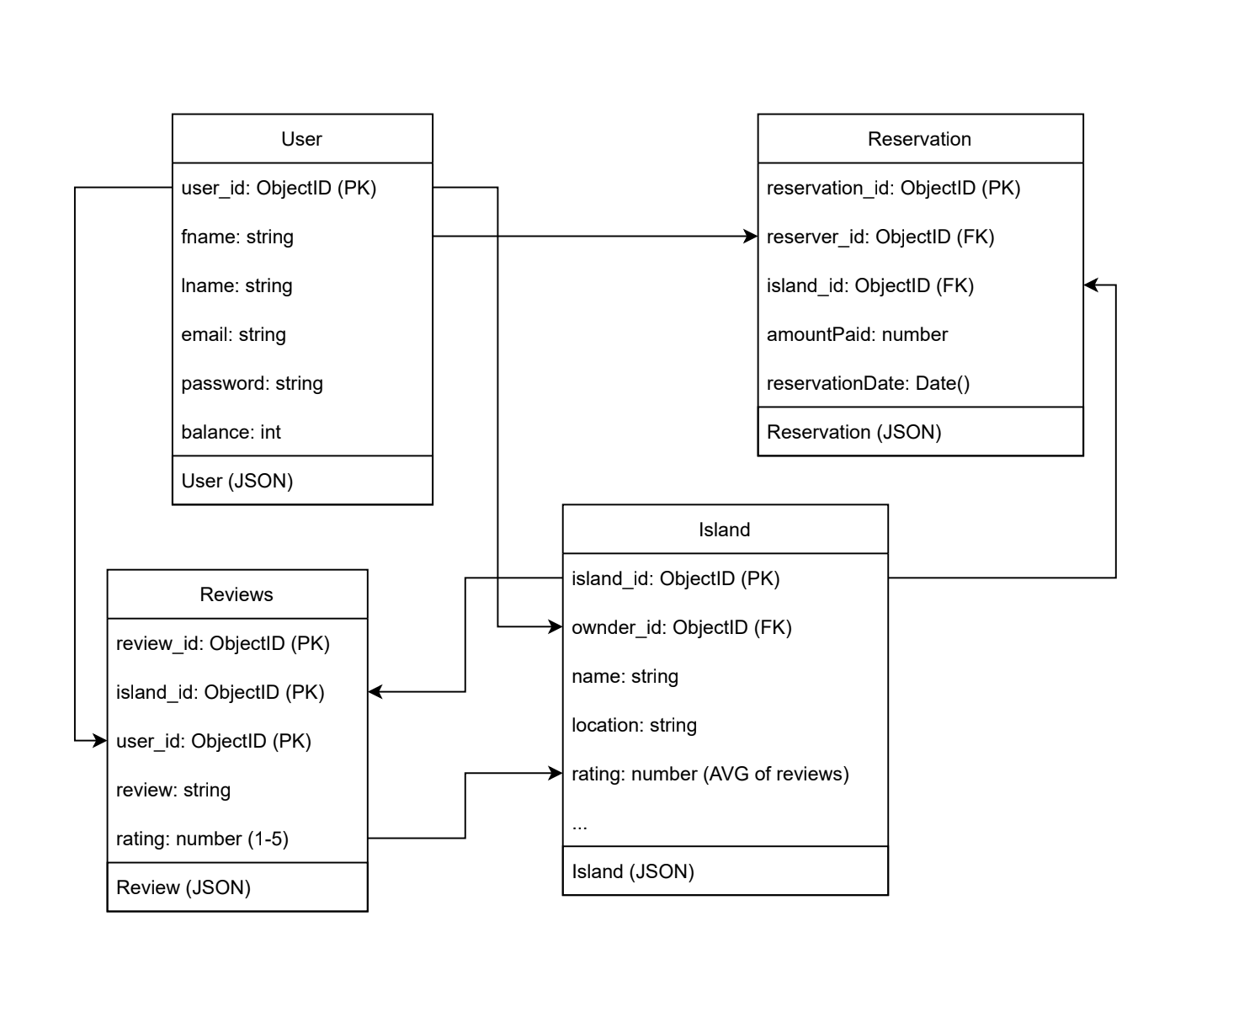
Database Structure

Slide 11
Technologies Used
Frontend
CSS
ReactJS
JSX
Javascript
Google maps API (maps)
Backend
NodeJS (endpoints to communicate w db)
ExpressJS
Javascript
Mongoose (models to send data to db)
MongoDB (db)
Postman (endpoint testing)

Slide 12
Project Management Methods
3 Scrum meetings a week
30-60 min project discussions after scrum meetings (3x a week)
Discuss specific challenges and work on solving them
Pair programming
Scrum boards
software: Jira
Github
Version control
Sprint planning and Sprint reviews
Notes:
3 Scrum meetings a week
In-person & Zoom
Scrum Questions
30-60 min project discussion after scrum meeting (3X A week)
In-person & Zoom
Discuss specific challenges and work on solving them
Pair Programming
2 Working at the same time to tackle the same task
Scrum Boards
Jira software
Task assignment/manager
Github
Version control

Slide 13
What we enjoyed and did not enjoy
Enjoyed
Collaborating as a team
Learning new technologies
In-person meetings
Designing and implementing a product
Did not Enjoy
Not having a consistent TA meeting for more than 4 weeks
Disagreement over which technologies to use
Working around 7 different schedules
Inconsistent communication at first
Notes:
Enjoyed
Collaborating as a team
Learning new Technologies
In-person meetings
Designing and implementing a product
Did not Enjoy
Not Having a consistent TA Meeting for more than 4 weeks
made us feel lost
Disagreement over which technologies to use
Working around 7 different schedules

Slide 14
What have we learned?
Bigger groups are harder to manage
Preparing well pays off a lot and saves a lot of stress
Ambiguity + lack of communication = lost time and effort
Being a leader is difficult but you’re not alone

Slide 15
Thank you!
any questions?

